Slide 1

EDA HOTEL BOOKING ANALYSIS
Presented by
Rashmi, Krishna & Shreya
Guided by:
Abhishek sir

Slide 2

PROJECT SUMMARY
This project focuses on analyzing a dataset containing information for both city hotels and resort hotels. The dataset includes details such as booking time, length of stay, number of adults, children, and babies, and the number of available parking spaces.
To gain insights into booking patterns and customer behavior using EDA
The main goal is to understand reasons for booking cancellations across various parameters from both the hotel and customer perspectives

Slide 3
Steps we follow
Create a Problem statement
Identify the data you want to analyze
Data Exploration and Cleaning
Conduct Data Analysis
Data Visualization

Slide 4
Problem Statement
The hospitality industry is highly dynamic, with various factors influencing hotel booking rates and customer preferences. With the increasing competition and evolving customer expectations, it is crucial for hotels to analyze their booking data to identify patterns and trends that can inform strategic decisions. The primary challenges that an EDA hotel booking analysis aims to address are:
Booking Cancellations
Customer Preferences
Revenue Optimization
Operational Efficiency

Slide 5
Data We Explore
This dataset contains booking information for both a city hotel and a resort hotel. It includes details such as booking dates, length of stay, the number of adults, children, and babies, and available parking spaces. This dataset has 119390 rows and 32 columns.
The duplicate value count is 31994 rows.
The columns “company”, “agent”, and “country” contain null values.
Instead of having separate columns for adults, children, and babies, we will consolidate them into a single column named total number of people

Slide 6
Data description
Hotel: Type of hotel(City or Resort)
is_cancelled: If the booking was cancelled(1) or not(0)
lead_time: Number of days before the actual arrival of the guests
arrival_date_year: Year of arrival date
arrival_date_month: Month of arrival date
arrival_date_week_number: Week number of year for arrival date
arrival_date_day_of_month: Day of arrival date
stays_in_weekend_nights: Number of weekend nights(Saturday or Sunday) spent at the hotel by the guests.
stays_in_weel_nights: Number of weeknights(Monday to Friday) spent at the hotel by the guests.
adults: Number of adults among the guests
children: Number of children
babies: Number of babies
meal: Type of meal booked
country: country of the guests
market_segment: Designation of market segment
distribution_channel: Name of booking distribution channel
is_repeated_guest: If the booking was from a repeated guest(1) or not(0)

Slide 7
previous_cancellation: Number of previous bookings that were cancelled by the customer prior to the current booking
previous_bookings_not_cancelled: Number of previous bookins not cancelled by the customer prior to the current booking
reserved_room_type: Code from room type reserved
assigned_room_type: Code of room type assigned
booking_changes: Number of changes made to the booking
deposit_type: Type of deposite made by the guest
agent: ID of travel agent who made the booking
comapny: ID of the company that made the booking
days_in_waiting_list: Number of the days the booking was in the waiting list
customer_type: Type of customer, assuming one of four categories
adr: Average daily rate
required_car_parking_spaces: Number of car parking spaces required bt the customer
total_of_special_requesrs: Number of special requests made by the customer
reservation_statuse: Reservation status(Canceled, check-out or no-show)
reservation_status_date: Date at which the last reservation status was updated

Slide 8
Data Wrangling
Removed 31994 duplicate values.
In dataset we added three columns such as
Total no. of people =adults +children+babies
Total stay = stays_in_weekend_nights + stays_in_week_nights
Room_Status = IF([@[reserved_room_type]]==[@[assigned_room_type],"Desired","Un-Desired")
Removed ‘company’ column.
2 columns ‘agent’ and 'country’ have null values. The values from these columns are replaced by Other.
Addition of primary key

Slide 9
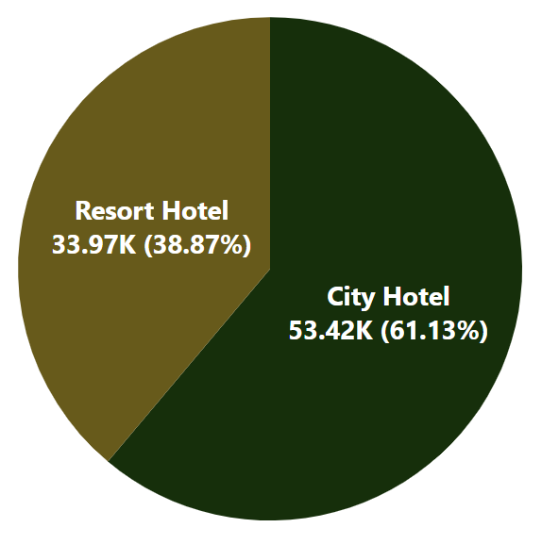
Distribution Of Bookings For Each Hotel
61.13% of guests preferred to book a City Hotel, while 38.87% preferred to book a Resort Hotel.
City Hotels can boost their revenue by expanding their range of services and amenities.
Resort Hotel should explore ways to attract more guests.

Slide 10
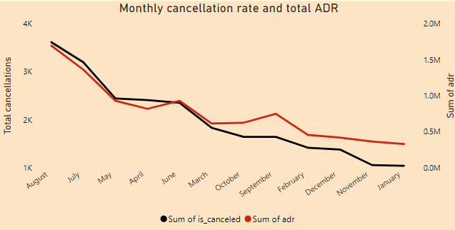
Monthly Cancellation Rate Correlate With Total ADR
A high cancellation rate coinciding with a high ADR for August and July
Adjust Pricing Strategy
Offer Promotions
Improve Booking Flexibility

Slide 11
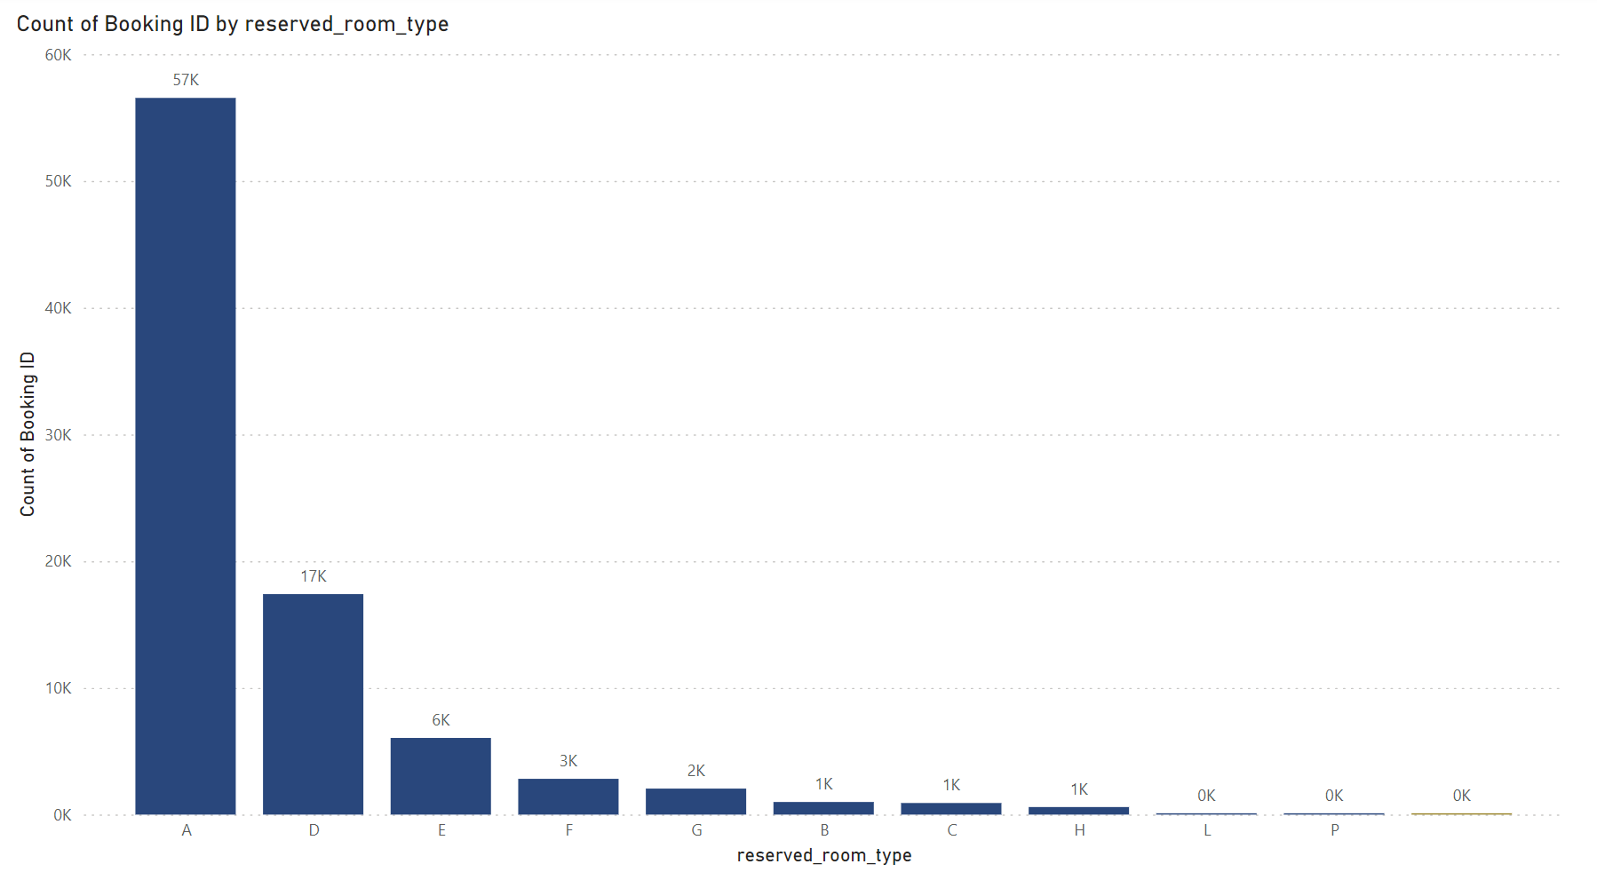
Most popular room type
Room types A and D are more popular
Price Optimization
Promote Amenities
Feedback and Improvement

Slide 12
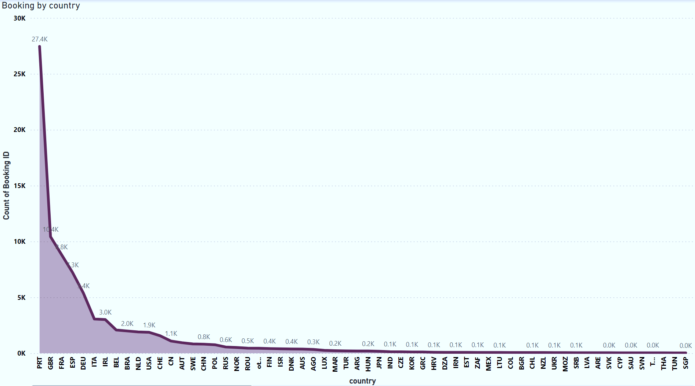
BOOKING TREND
Disparity in booking counts among different countries, with one country having a notably higher demand.
Targeted Marketing
Service Improvements

Slide 13
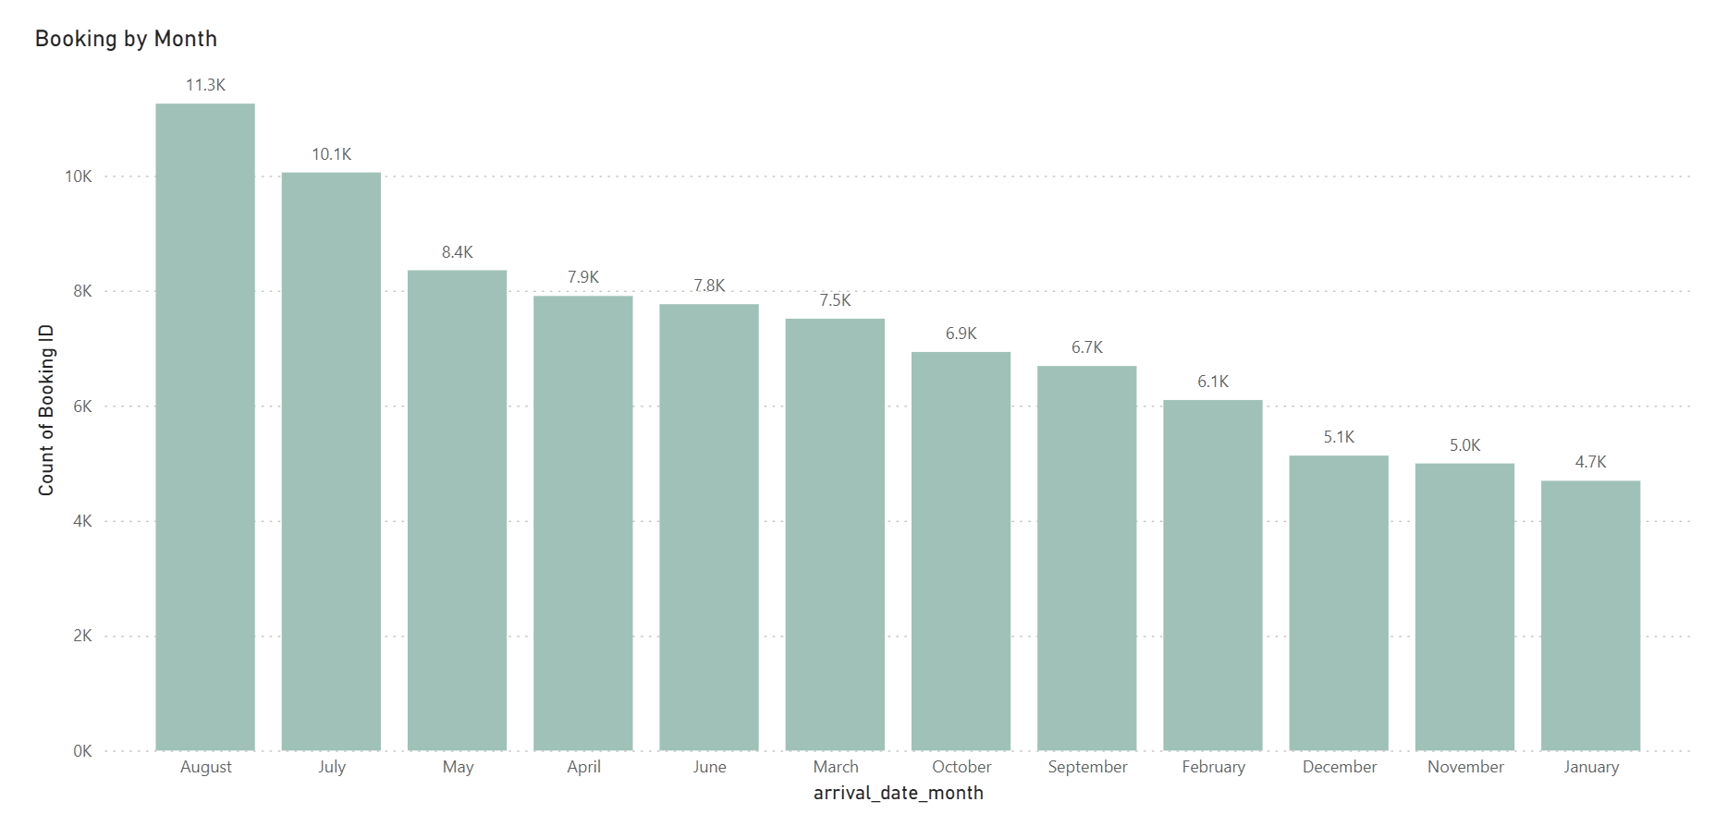
The graph suggests a seasonal trend in bookings, with summer months being the busiest.
Adjust room rates
Optimize room inventory
Staff level adjustment

Slide 14
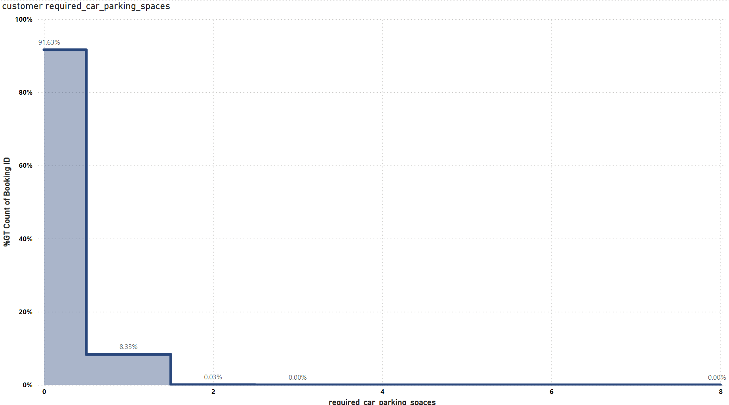
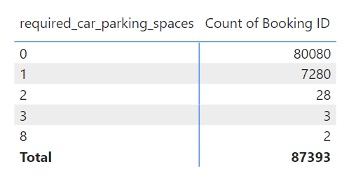
NEED OF PARKING SPACE
8.33% of customers need one parking spaces.
Parking Space Allocation
Parking Policies and Fees
Alternative Transportation Options

Slide 15
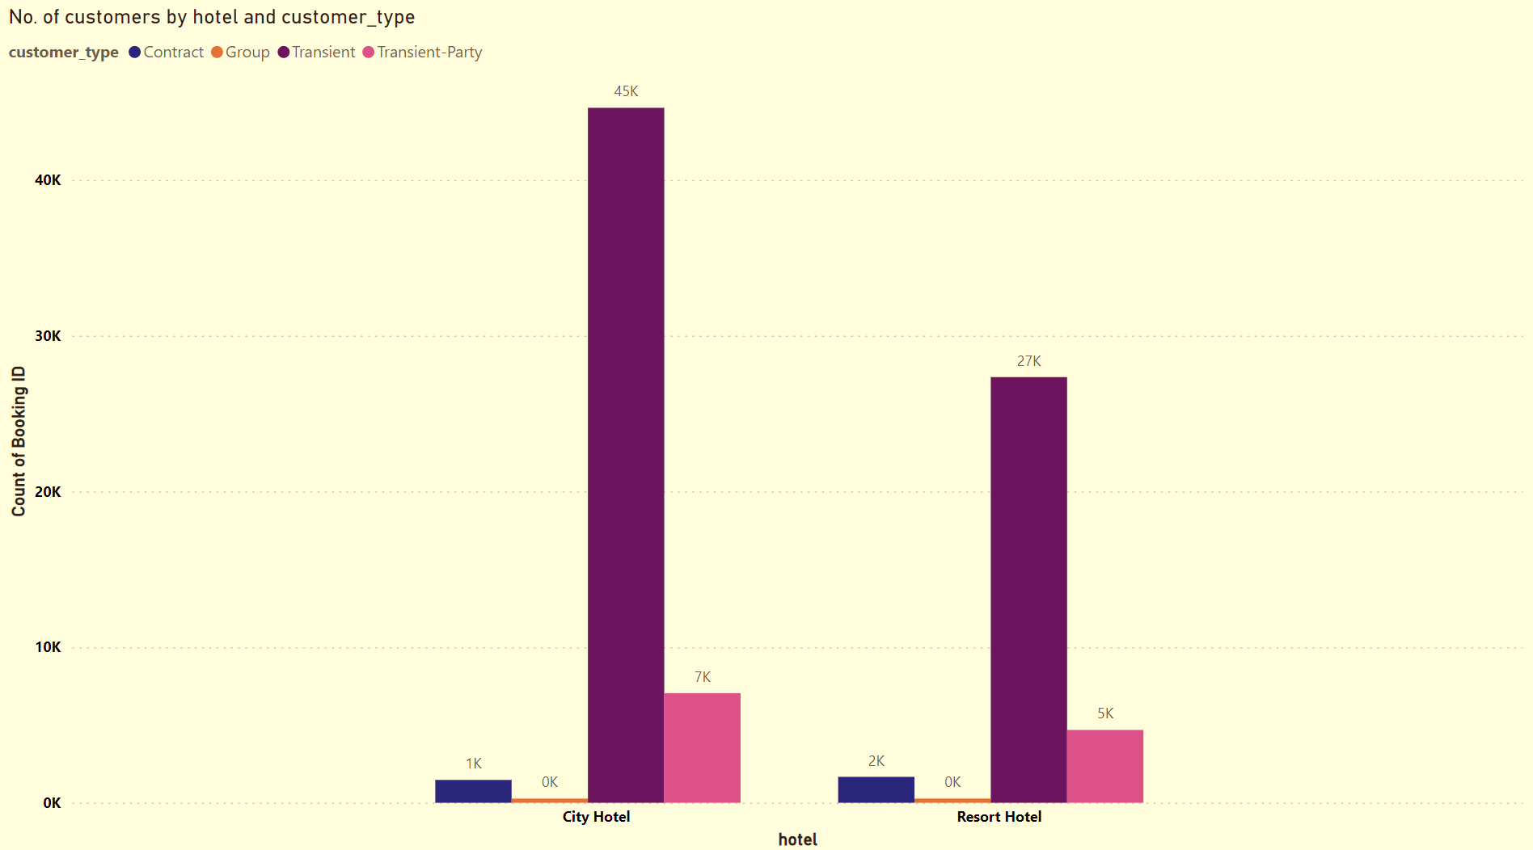
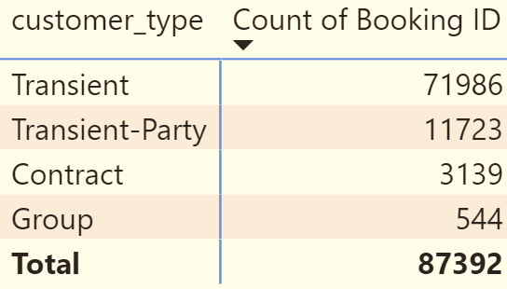
Types of customers
Here we can see that the City Hotel is more popular or accessible to a broader range of customers.
Business Strategy:
The City Hotel could focus on marketing to transient customers due to their higher numbers.
The Resort Hotel might need to explore strategies to attract more customers, especially in the transient and transient-party segments.

Slide 16
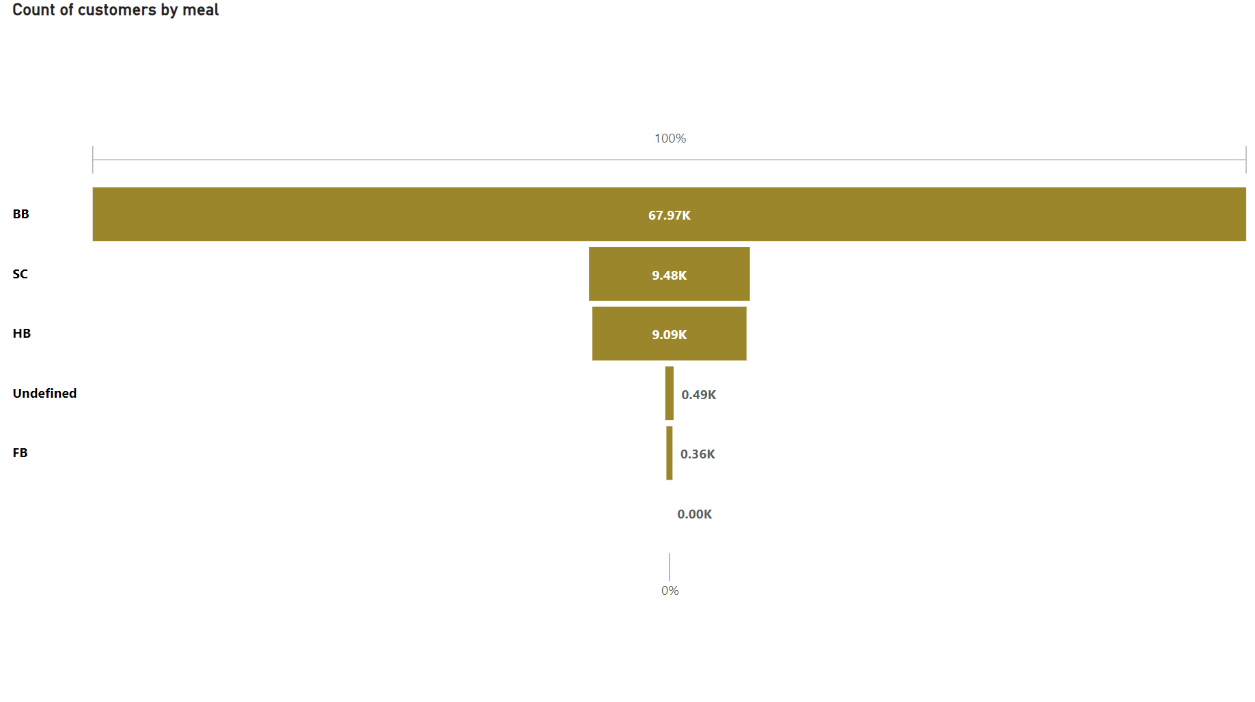
Meal Preference
Hotels can use this data to tailor marketing campaigns based on meal preferences.
Highlight BB benefits (e.g., complimentary breakfast) in promotional materials.
Offer special deals or discounts for HB packages to attract more customers.

Slide 17
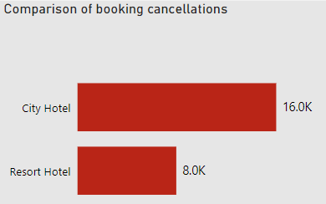
Booking cancellations between Resort Hotel and City Hotel
16K canceled bookings for City Hotel and 8K canceled bookings for Resort Hotel
Higher number of cancellations in City Hotel compared to Resort Hotel
Review Booking Policies
Improve Communication
Offer Incentives

Slide 18
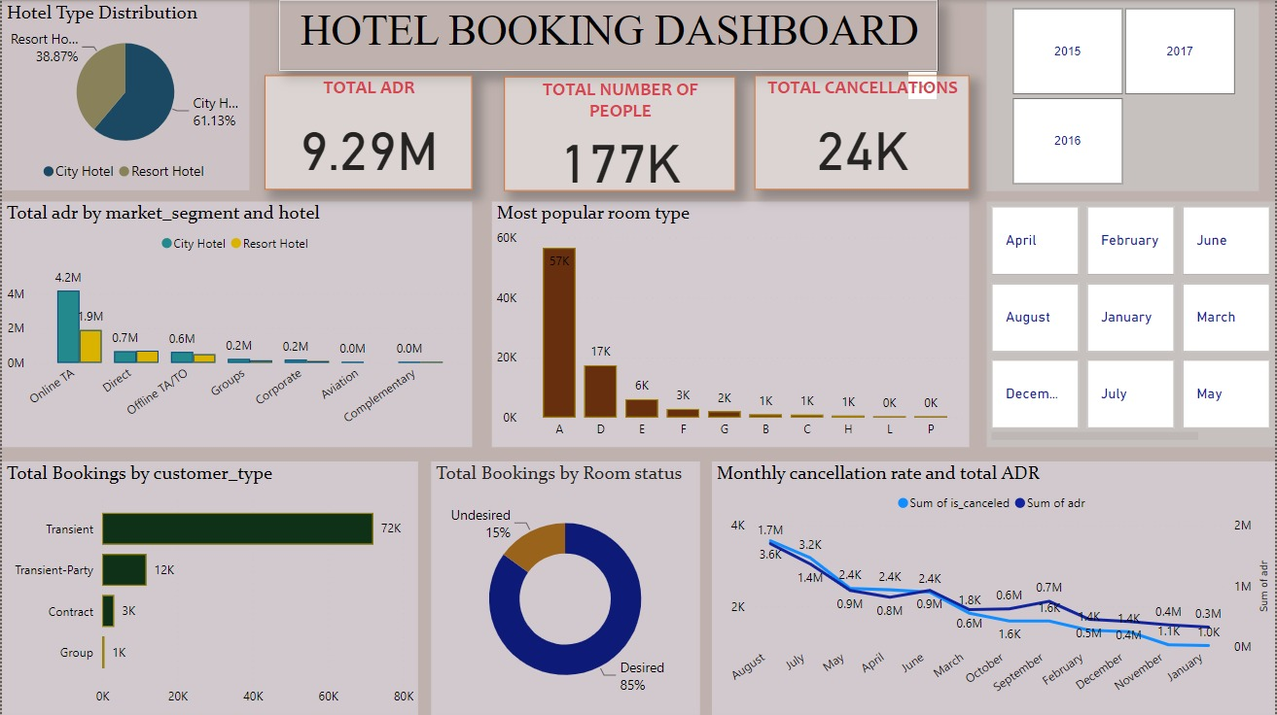

Slide 19
CONCLUSION
Booking Patterns: City hotels had a higher booking rate at 60%, compared to 40% for resort hotels1. This suggests that city hotels may be more in demand or have better marketing strategies.
Booking Cancellations : Understanding the reasons behind cancellations is crucial for optimizing revenue and occupancy. Adjust ADR based on demand and market conditions to attract guests while minimizing cancellations.
Proactively communicate with guests to reduce last-minute cancellations.
Customer Behavior: The analysis revealed preferences for room types, with Room type A being the most preferred1. Additionally, BB type food was the most popular among guests1.

Slide 20
Repeat Guests: The percentage of repeat guests was found to be low. This could point to potential areas for improvement in customer retention strategies.
Optimal Booking Time: The study aimed to find the best time to book a hotel room and the optimal length of stay to get the best daily rate3. This information can be valuable for customers looking to maximize value.
Special Requests: The impact of special requests on bookings and customer satisfaction was also studied, highlighting the importance of personalized services
Parking space: Understanding customer parking preferences allows hotels to enhance guest experiences, optimize space, and contribute to sustainable urban planning.
Booking Trend: Identify the high-booking country and explore the reasons behind its popularity.

Slide 21

Any Question

Slide 22
Thank You

